Slide 1
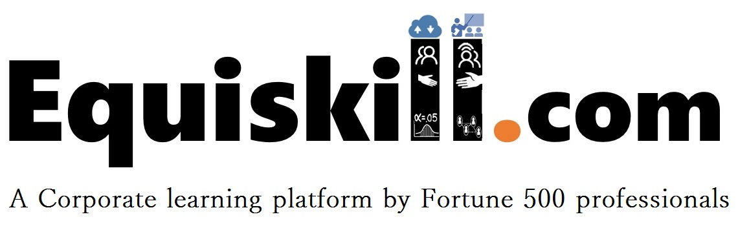

Segmentation and Clustering

Slide 2
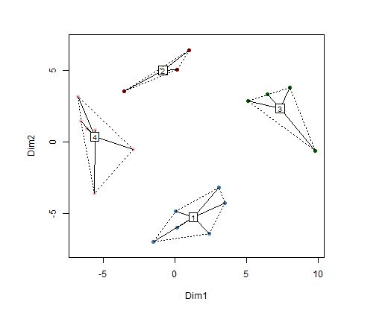

Clustering
Definition
Clustering is a concept which is used to group the data or observation among different segments so that the objects within a segment are similar and objects between segments are different.

Slide 3
Clustering
Application
Cluster analysis is being used in different applications.
Customer Segmentation
Competitive Products
Correlated product pricing
Geo-demographic segmentation
Data Mining
In general it is often used to split our data into segments and perform subsequent analysis within each segment in order to achieve segment specific insights

Slide 4
Clustering
Clustering Algorithm
K-means Clustering
This is one of the most commonly used unsupervised clustering algorithm
In this method we classify each observation in a predetermined number of clusters-“k”. The classification and allocation of each observation in the clusters is based on a measure of closeness (distance)
Most commonly used distance measures are Euclidian and Manhattan distances.
.

Slide 5
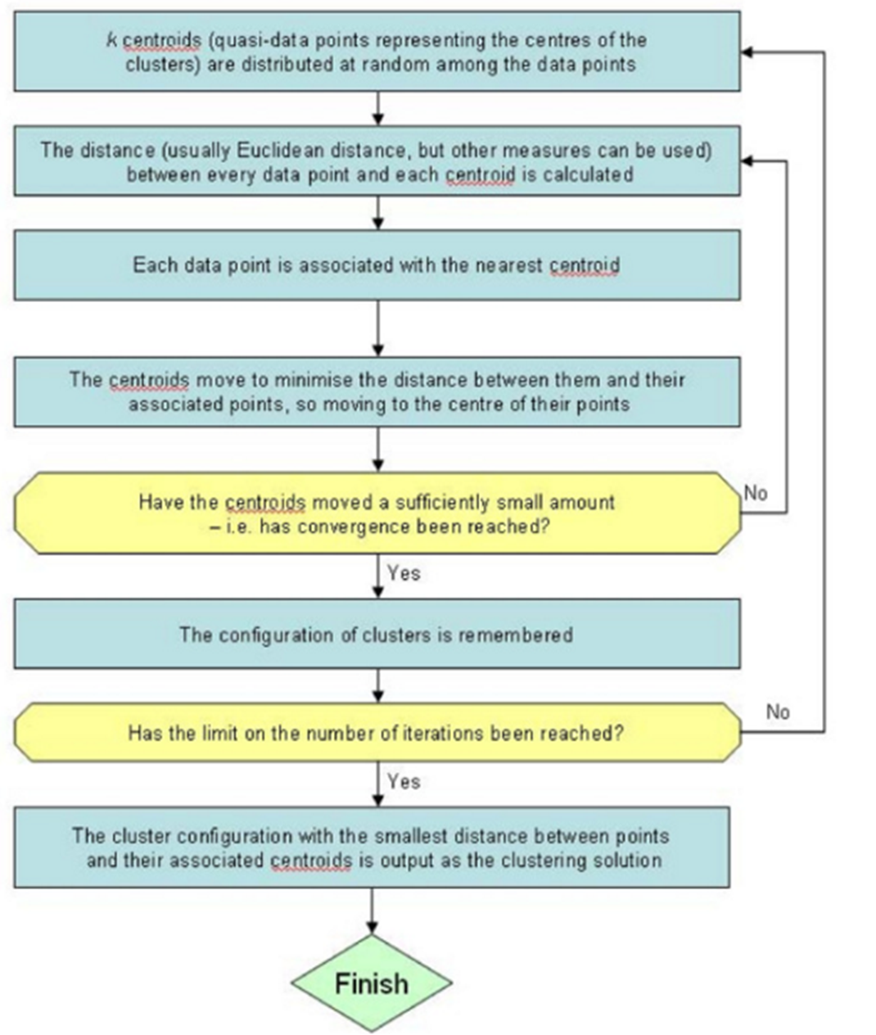
Clustering
Clustering Algorithm- Functioning

Slide 6
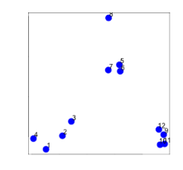
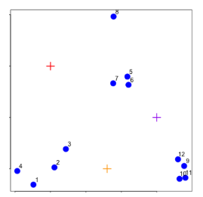
Clustering
Clustering Algorithm- Functioning
Step 1
Step 2

Slide 7
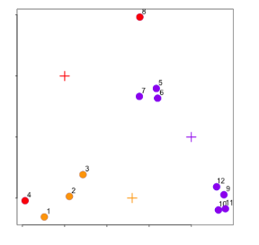
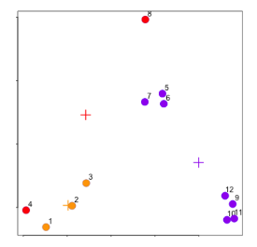
Clustering
Clustering Algorithm- Functioning
Step 3
Step 4

Slide 8
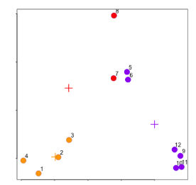
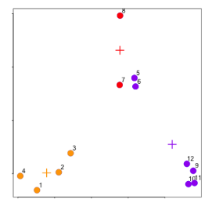
Clustering
Clustering Algorithm- Functioning
Step 5
Step 6

Slide 9
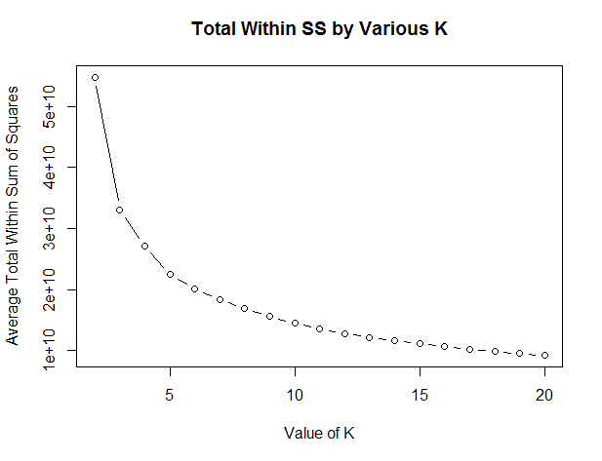
Clustering
Clustering Algorithm- Functioning

